Slide 1



Introduction to Google Colab
Ahmad Fathan Hidayatullah, S.T., M.Cs.

Slide 2
Google Colab?
Google Colab is a free cloud service which comes with pre installed machine learning frameworks like Tensorflow, free GPUs and TPUs to run on.
It allows us to write and execute Python in our browser, with:
Zero configuration required
Free access to GPUs
Easy sharing

Slide 3
Getting Started
Log in to your Google account, then go to this link
https://colab.research.google.com

Slide 4
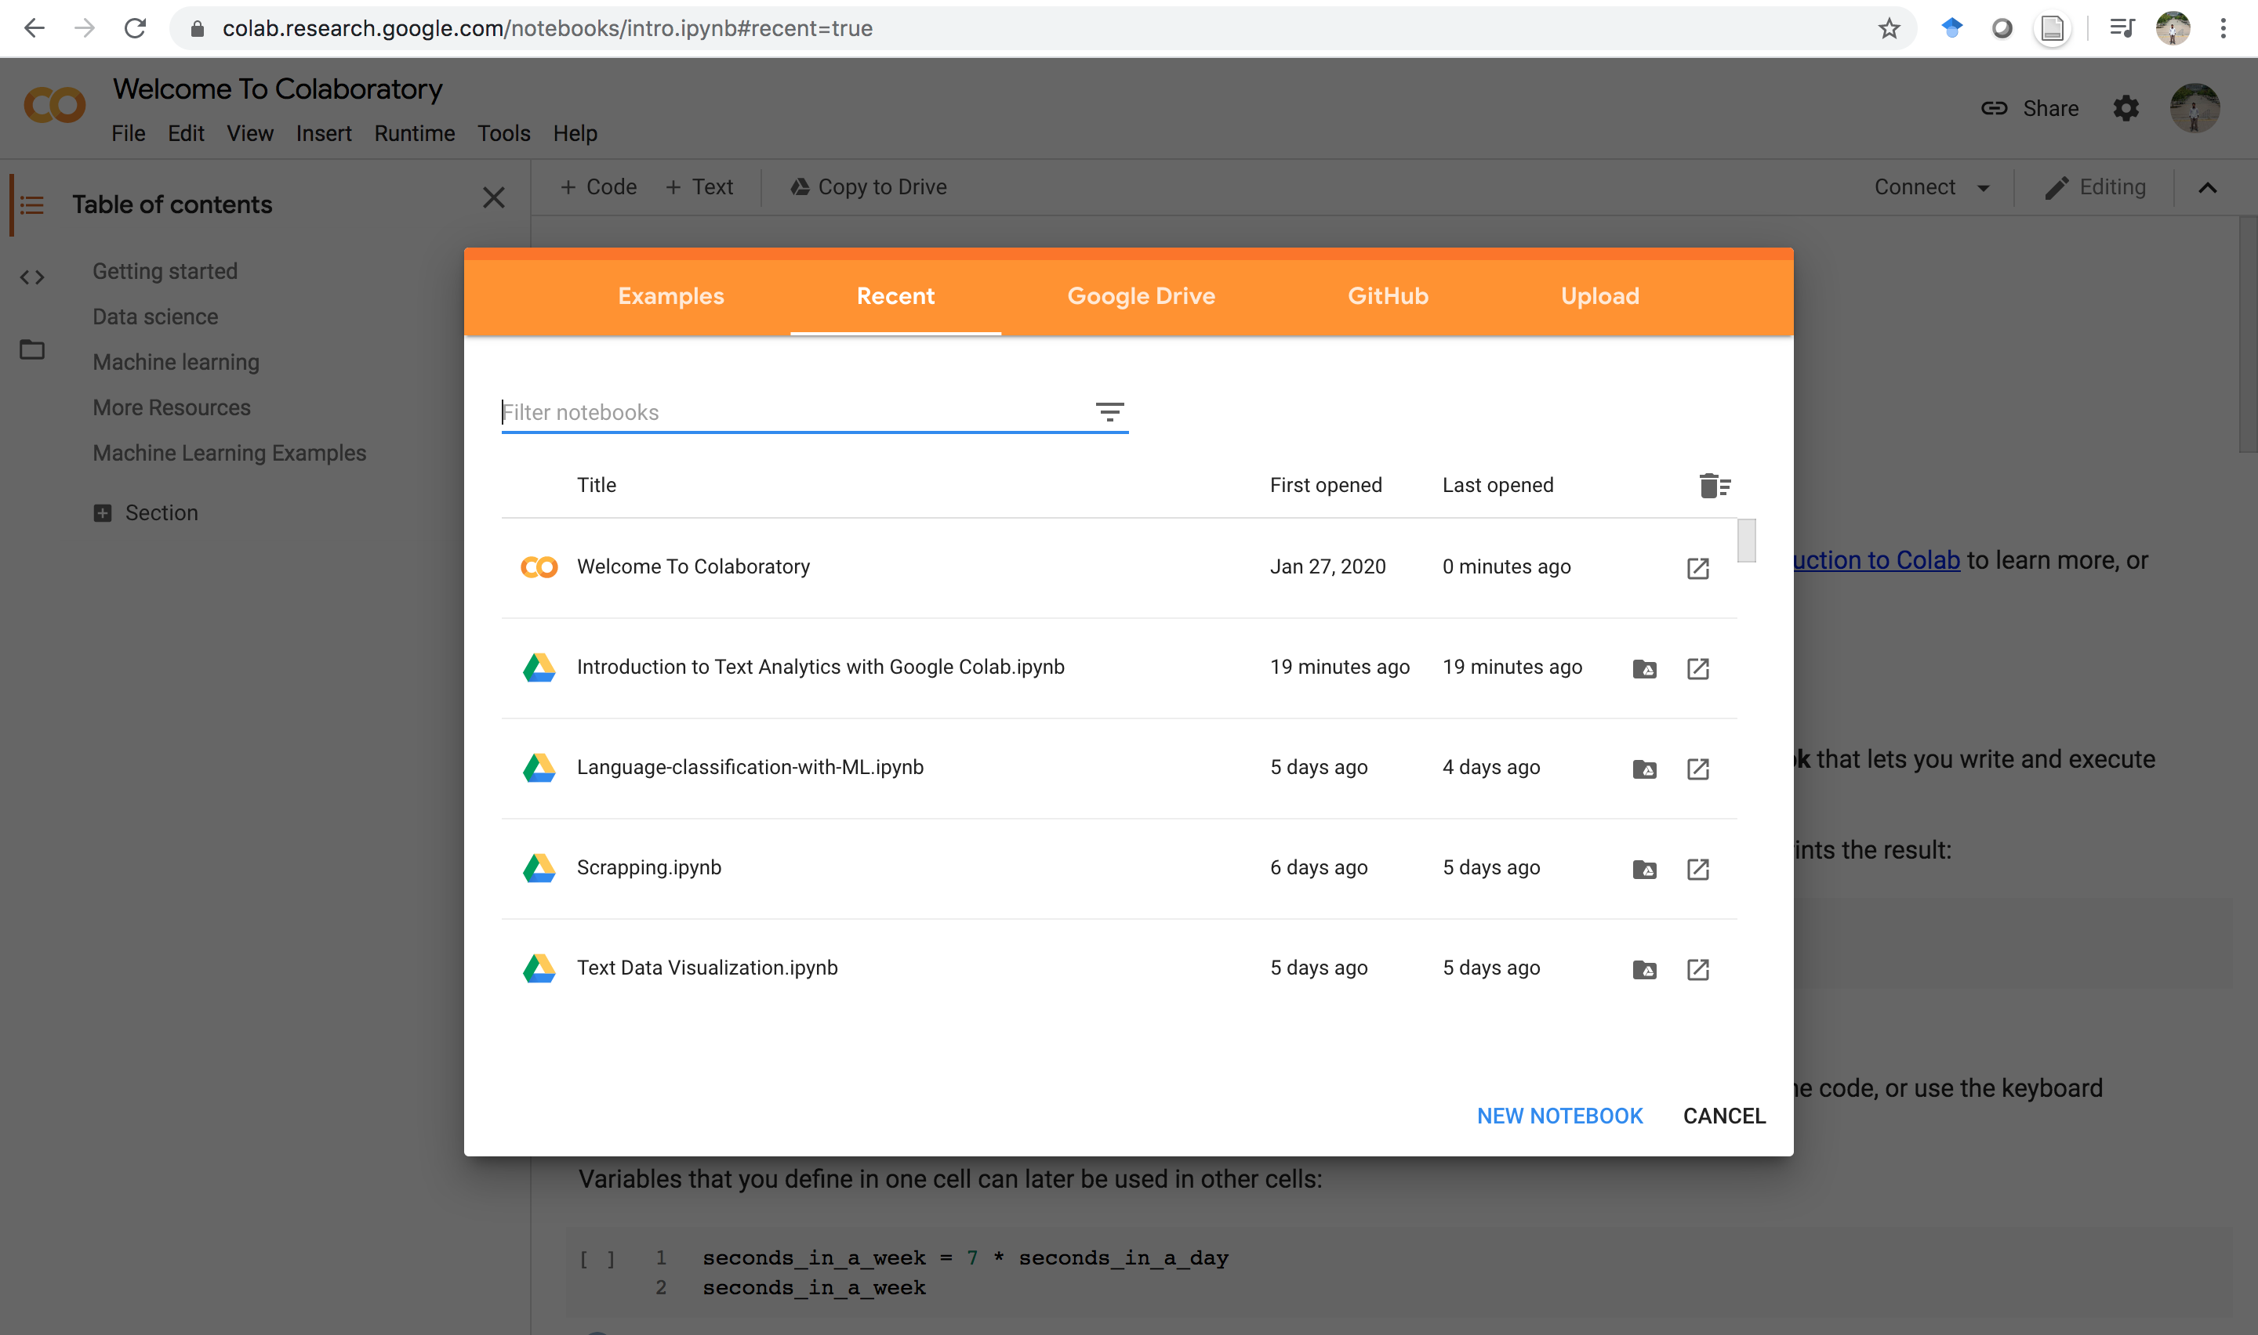
Google Colab Pop Up

Slide 5
Create New Notebook
To create new notebook, click “NEW NOTEBOOK”.
Click here

Slide 6
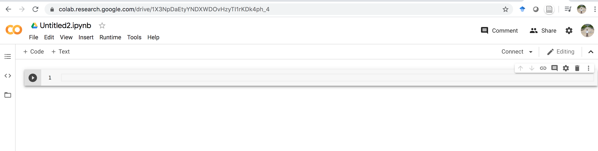
Rename Your Notebook
Rename here …

Slide 7
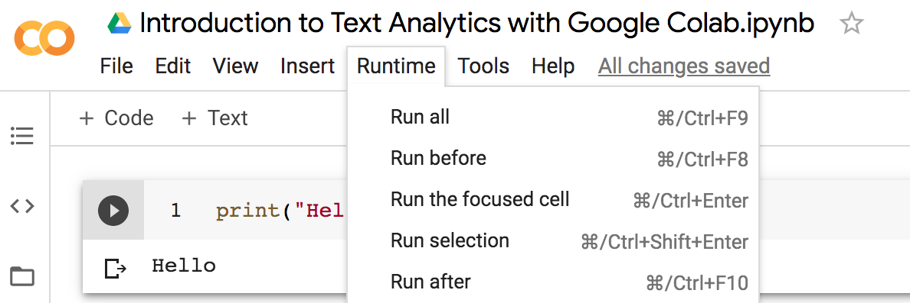
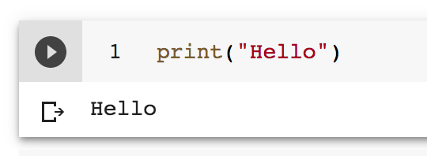
Run The Code
To run the code we can choose one of the following ways:
Shift + Enter
Ctrl + Enter (Windows)
Command + Enter (Mac)
Click the triangle on the left:
Choose one of the following dropdown menu:

Slide 8
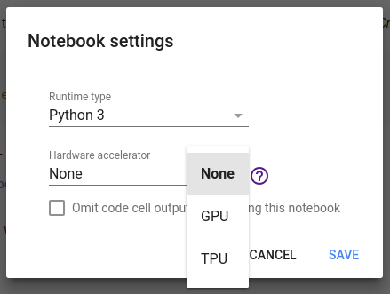
Change Runtime Type
We can change runtime type by selecting Python 3 or Python 2.
We can also use hardware accelerator by selecting GPU or TPU.

Slide 9
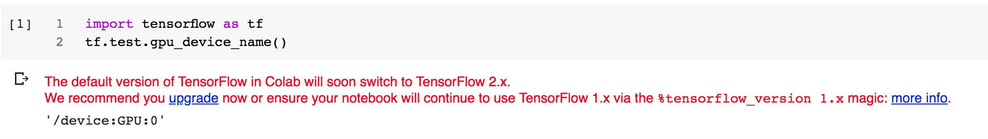
Verify GPU

Slide 10
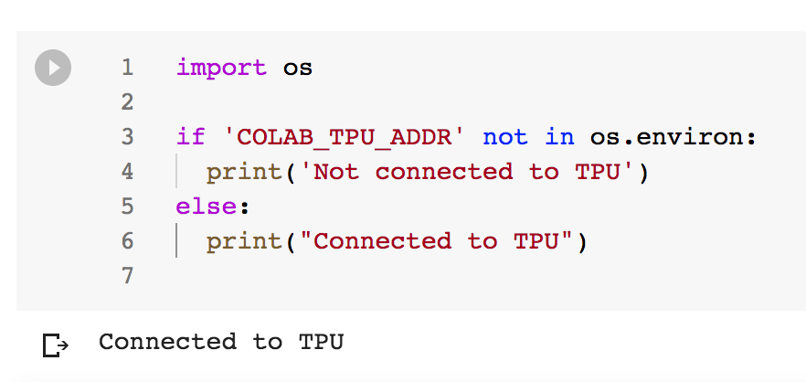
Verify TPU

Slide 11
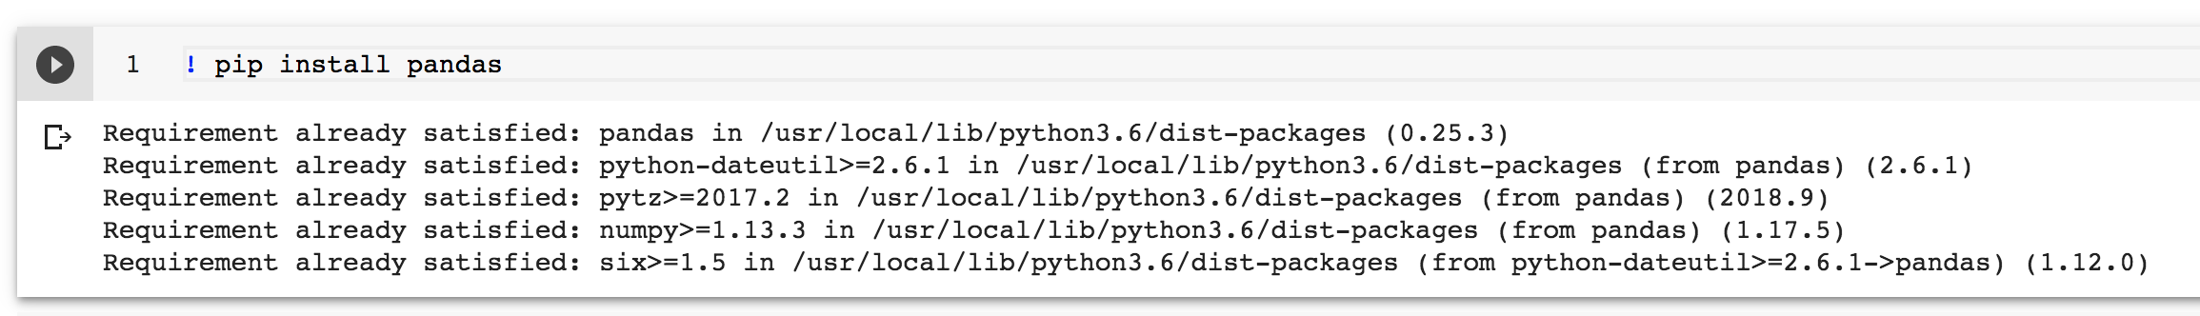
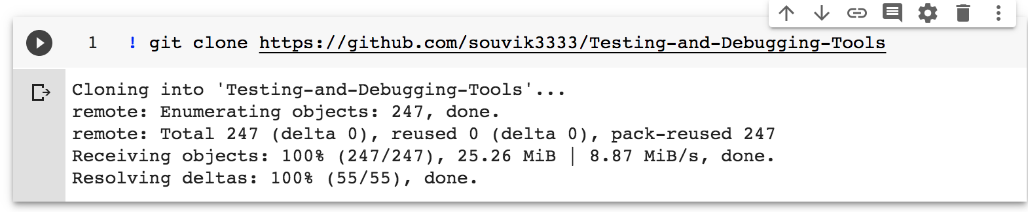
Installing Library
Use pip to install any package
Use git clone command

Slide 12
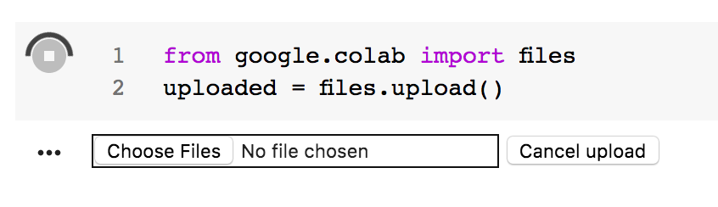
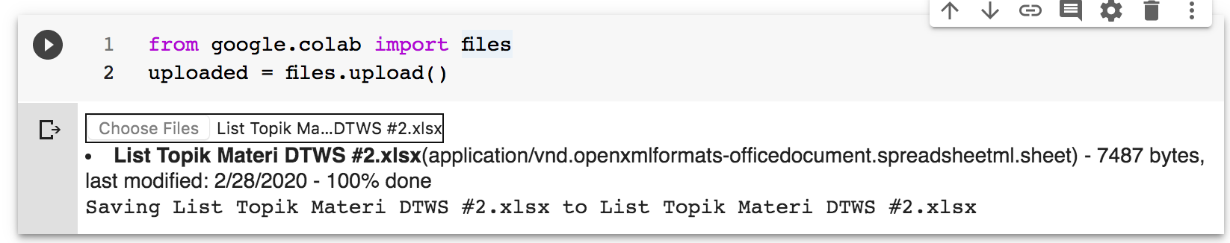
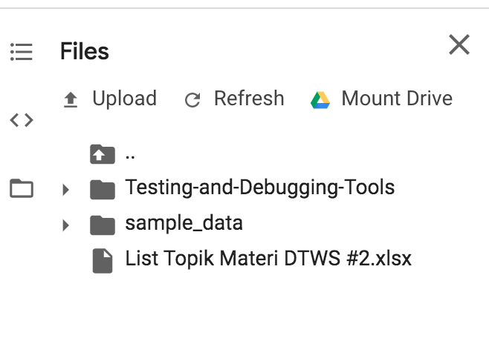
Upload File

Slide 13
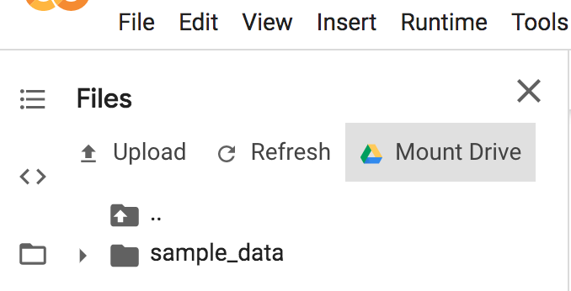
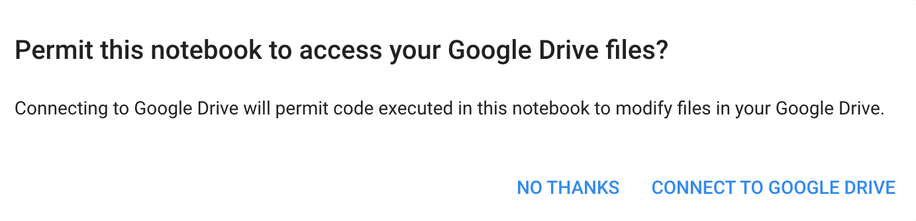
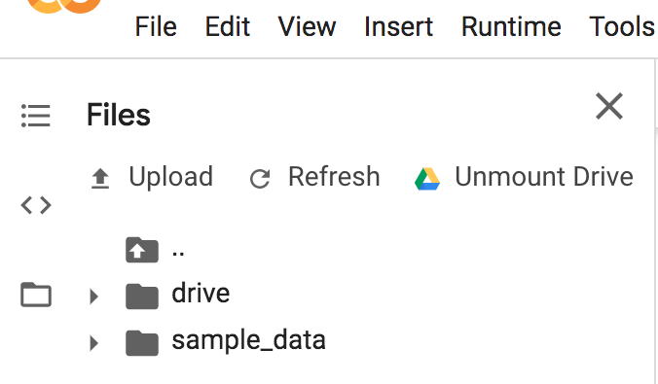
Mounting Google Drive
1
Click “Mount Drive”
2
Click “CONNECT TO GOOGLE DRIVE”
3
Google drive mounted

Slide 14
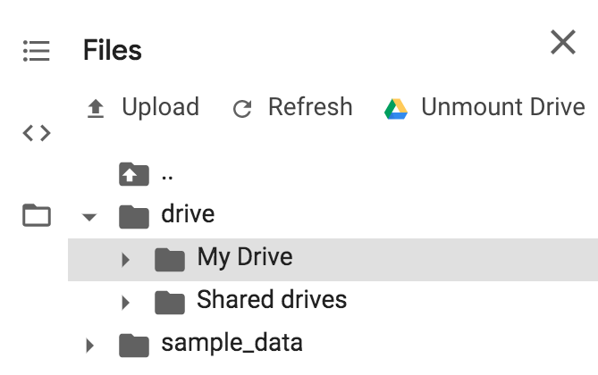
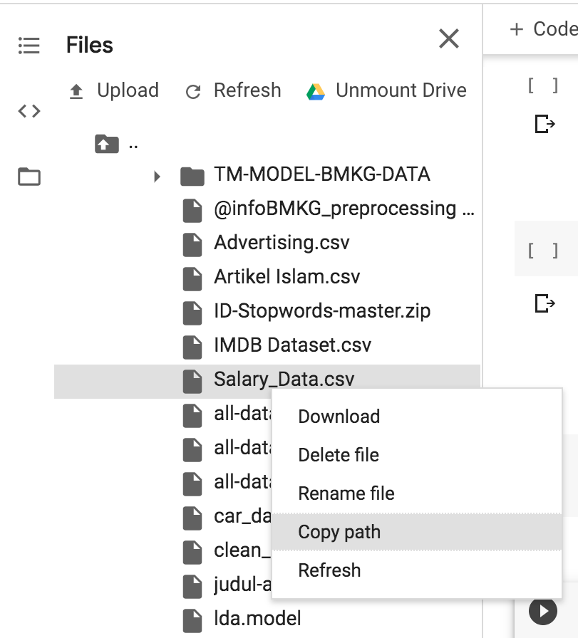
Load File from Google Drive
1. Find your files through “drive → My Drive → …”
2. Right click then click “Copy path” on your file

Slide 15
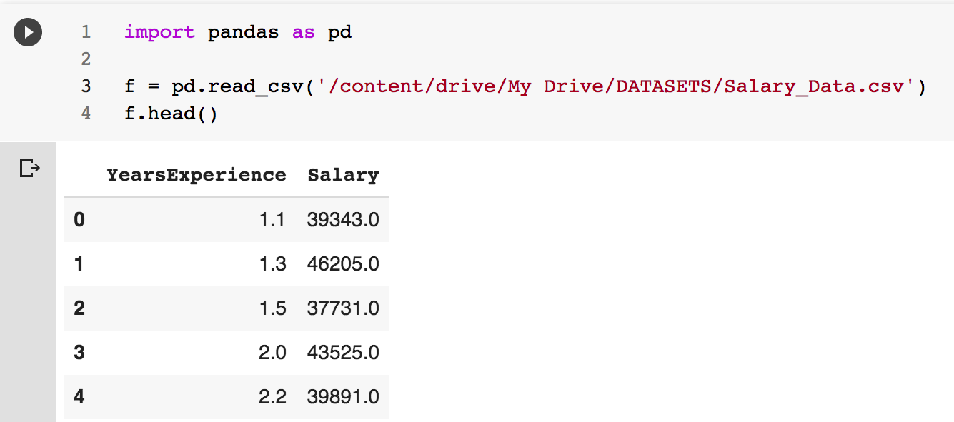
Load File from Google Drive

Slide 16
References
https://colab.research.google.com/notebooks/intro.ipynb#
https://shranith.github.io/2018/10/28/google_colab_intro.html
https://www.geeksforgeeks.org/how-to-use-google-colab/

